Slide 1

CreatorPilot
An AI Co-Pilot & Pre-Director Engine that transforms raw footage into trend-aligned, optimized social content.
Presenter Sneha Singh

Slide 2
The Post-Production Friction & Uncertainty
Time Imbalance
Content Self-Doubt
Distribution Blindness
Creators spend 80% of time editing, captions, and guessing trends vs 20% filming
No objective feedback before posting on hook quality, pacing, or visual appeal.
Presentation Title

Slide 3

Who Experiences This Pain Point?
Short-Form Creators
Reels, Shorts, and TikTok creators struggling to keep up with rapid 48-hour trend decays.
Solo YouTubers
One-person teams overwhelmed by video editing, thumbnail generation, and SEO copy.

Slide 4

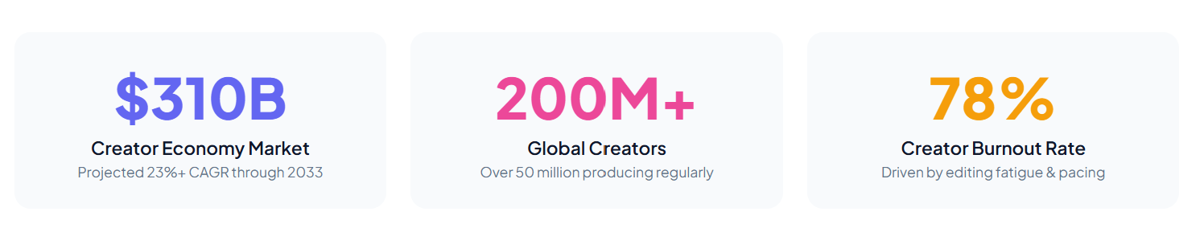
Why Solve This Problem Now?
Saving creators 5 hours per week on post-production directly unlocks higher output and prevents creator burnout.
This Photo by Unknown Author is licensed under CC BY-SA

Slide 5
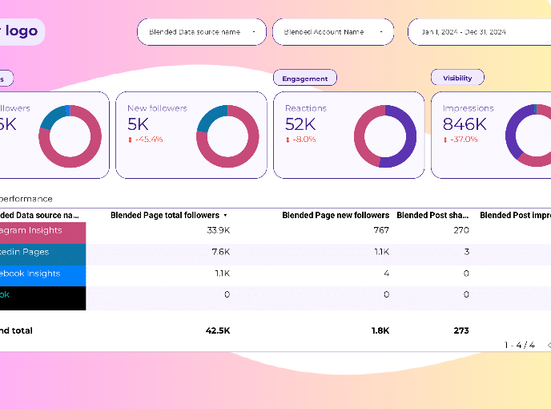
CreatorPilot: Web App + AI Director API
Objective Content Critique
Evaluates visual hook, audio clarity, and pacing before publishing.
Niche Trend Matching
Filters audio & topic trends specifically for your audience demographic.
Humanized Custom Persona
Auto-generates descriptions and covers tuned to your unique brand voice.

Slide 6
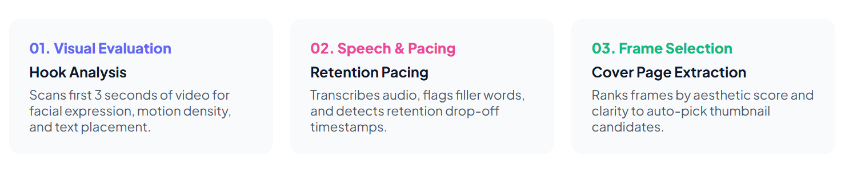
Where Does AI/ML Drive Value?

Slide 7
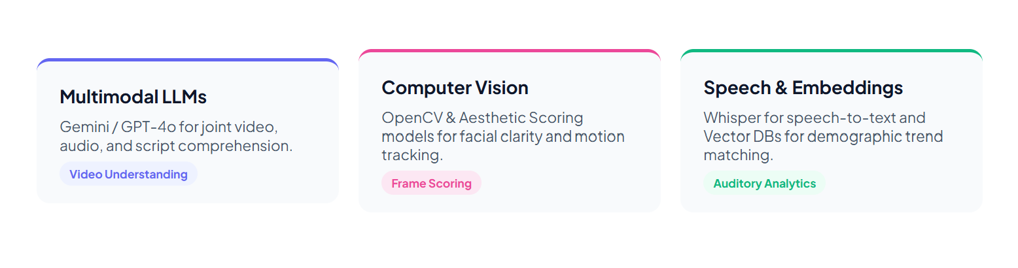
AI & Machine Learning Tech Stack

Slide 8
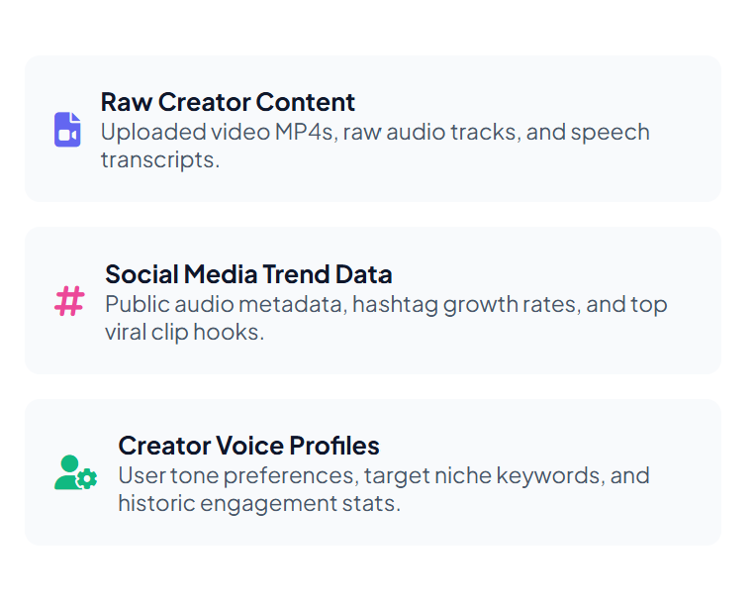

Core Data Pipeline Requirements

Slide 9

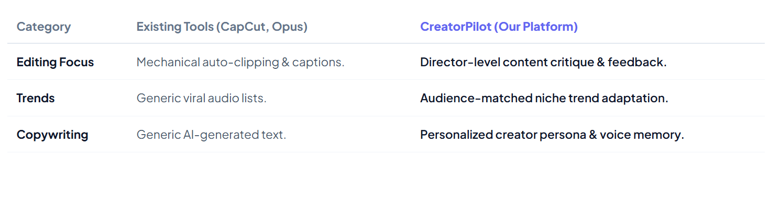

Existing Landscape vs. Market Gaps

Slide 10



What Sets CreatorPilot Apart?
Objective Hook Score
Humanized Voice Engine
Smart Distribution Engine
Tells creators if the first 3 seconds grab attention before hitting post.
Learns individual tone preferences so captions never sound like generic AI.
Combines ideal posting times with aesthetic frame covers for maximum reach.

Slide 11
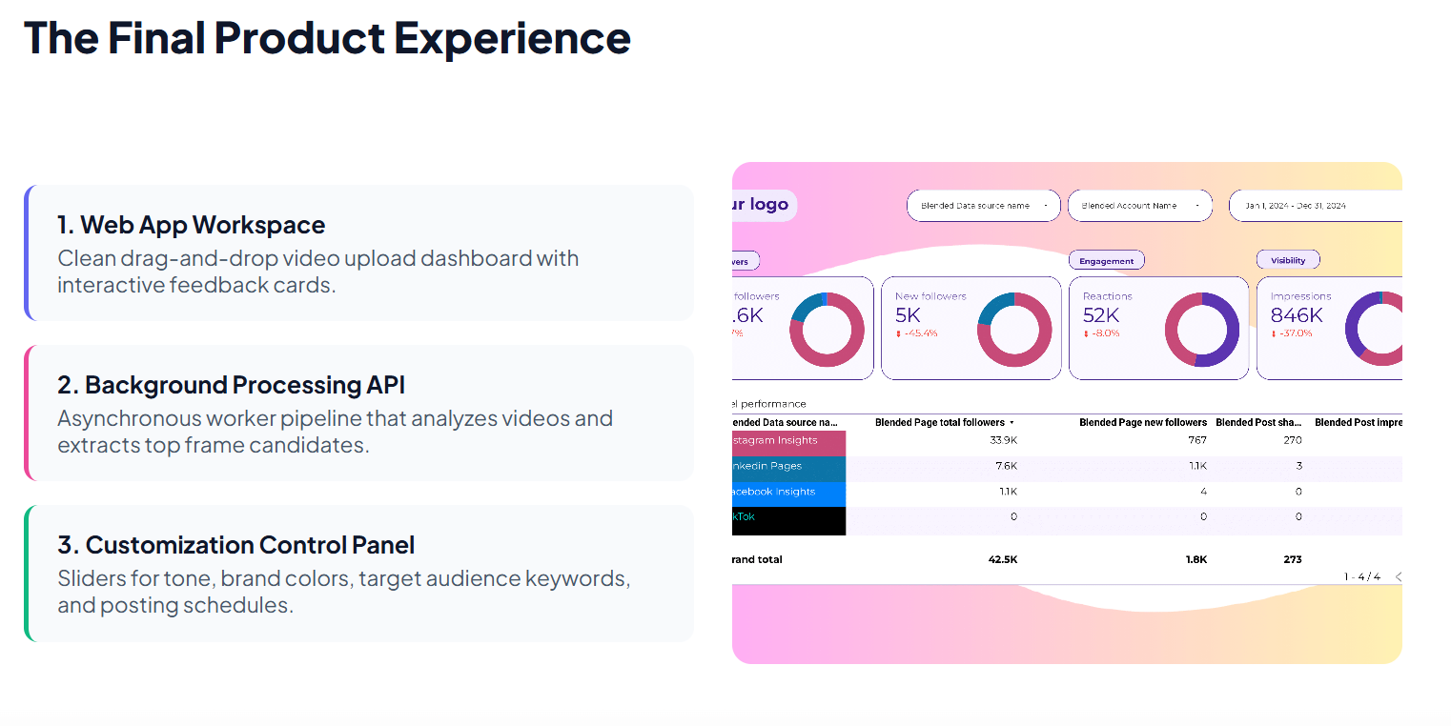

Slide 12
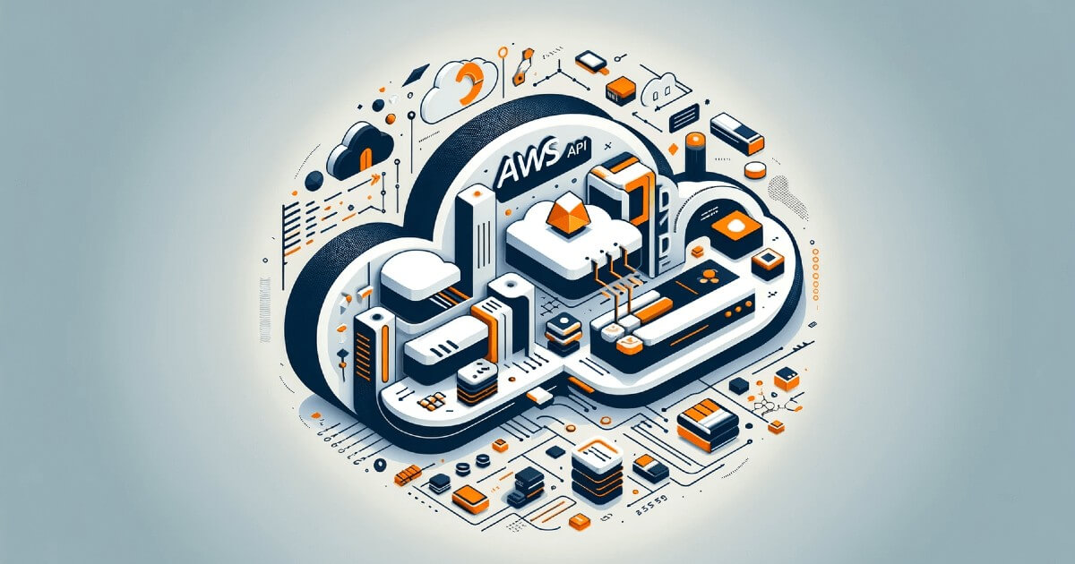
Key Technical & Operational Challenges
AI Subjectivity
Training models to judge "good content" across diverse creative genres. Training models to judge "good content" across diverse creative genres.
Bandwidth & Latency
Processing large raw 4K video files requires fast video compression pipelines.
Social API Restrictions
Platform API limits and rapid changes to social media algorithm rules.

Slide 13

Sources & Industry Research
Global Creator Economy Market Growth
Creator Tool Adoption & Workflow Friction
Grand View Research / Fortune Business Insights
Gigapay Global Creator Economy Repor

Slide 14


Summary
Eliminate Bottlenecks
Reduces post-production time by 5+ hours weekly, letting creators focus on filming.
Data-Driven Insights
Combines visual hook scoring with hyper-targeted niche trend matching.

Slide 15




Thank you
By-SNEHA SINGH
Btech - IT (1st Sem)

